Slide 1




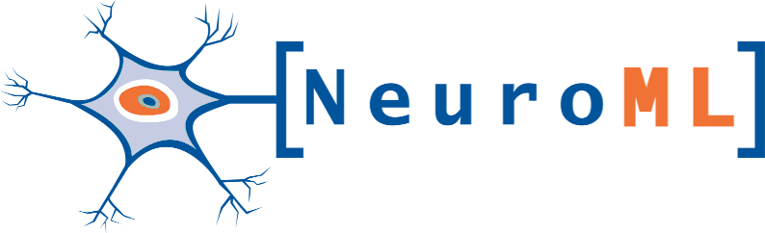
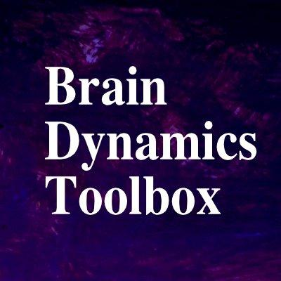








INCF/OCNS Software Working Group
NeuroFedora
Open Source Brain
PyNN
Ankur Sinha, Shailesh Appukuttan, Stewart Heitmann, Caglar Cakan, Nikola Jajcay, Christoph Metzner, Felix B. Kern, Zohreh Vaziri, Amelie Aussel, Brent Huisman, Malin Sandström, Daniele Avitabile, Thomas Nowotny, James Knight, Charl Linssen, Andrew P. Davison, Shavika Rastogi, Marcel Stimberg, Joe Graham
Github: https://ocns.github.io/SoftwareWG/ & https://github.com/OCNS/SoftwareWG/discussions Neurostars: https://neurostars.org/t/ocns-infrastructure-software-tools-sig-meet-and-greet-initial-discussions

